Slide 1
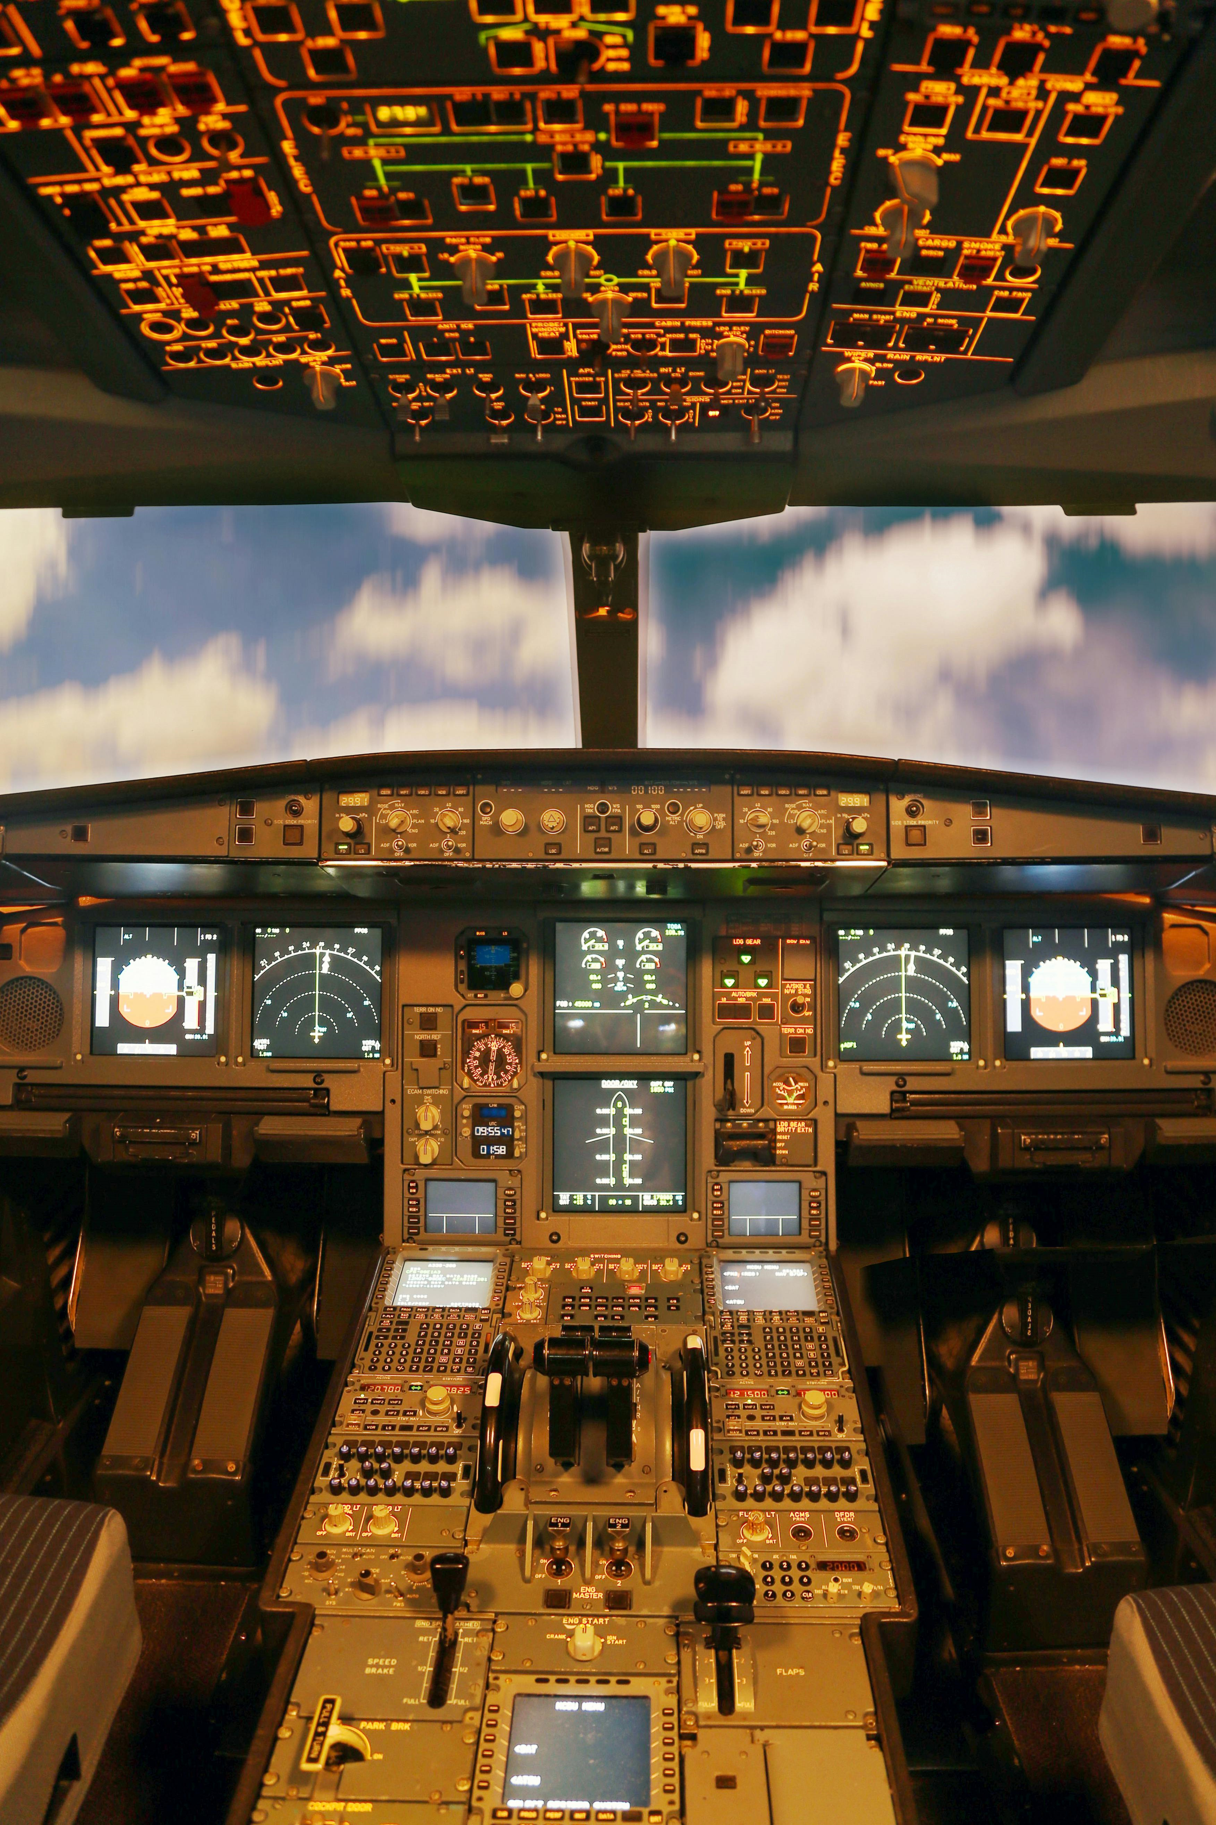
Evidence-based portfolio diversification for strategic entry into the aviation market by Abigael Kariuki

Slide 2

Outline of the presentation
Overview of the business problem
Data overview and main trends
Data analysis
Recommendations

Slide 3
Overview of the business problem
This project analyses aviation accident data to assess the risk of fatal and severe accidents to guide the company's entry into the aviation industry
Key factors analysed:
Flight phases: impact of takeoff, landing, cruise etc on accident severity.
Weather conditions: how factors like rain, fog, and wind contribute to accidents.
Aircraft types and engines: correlation between aircraft models, engine types and accident fatality risk.
Purpose of flight: relationship between accident severity and flight purpose (commercial, private, training).
Accident severity: classification of accidents based on injury severity (fatal, serious, minor).
Business challenge: the company is expanding into aviation to diversify its portfolio but lacks knowledge about the risks involved in entering this market
Goal: assesses the risks of entering the aviation industry, focusing on factors that impact safety and success. The findings will inform decisions on managing risks and ensuring safety as the company expands into aviation operations.

Slide 4
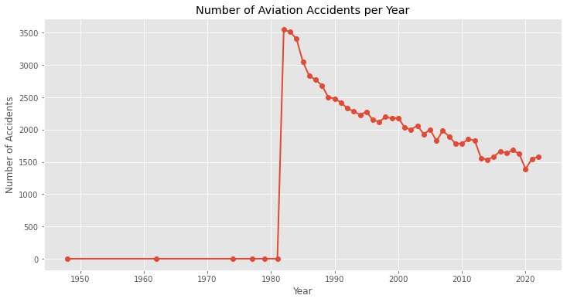
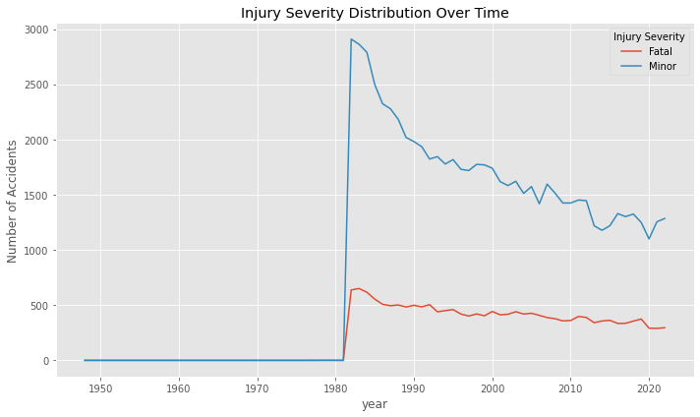
Data overview and main trends
Data source: National Transportation Safety Board (NTSB) aviation accident data (1962- 2023).
Total accident records: Over 50,000 aviation accident records, with the most prevalent accidents occurring in the 1980s.
Key trends
1980s peak: the number of total accidents per year was very high in the 1980s, exceeding 3,000 incidents annually. However, accidents have steadily declined since then, with accident frequency halving since that period.
Fatal and minor accidents: fatal accidents also peaked in the 1980s, with over 2,000 incidents, while minor accidents followed a similar decreasing trend over time.
Improved safety: over the decades, aviation has become progressively safer, even as global air traffic has increased significantly.

Slide 5
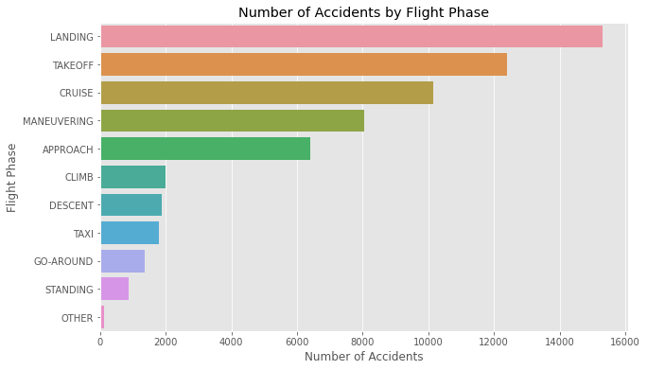
Data analysis: flight phases & accident severity
Number of and severity of accidents by flight phase:
Landing (15,320 accidents) and takeoff (12,404 accidents) have the highest number of accidents. Despite their high frequency, these phases have lower fatal and severe rates, with fatality rates of 1.8% and 14.5%, respectively.
Maneuvering (8,052 accidents) and climb (1,995 accidents) have fewer accidents overall, but their fatal and severe rates are much higher. Maneuvering has a fatal rate of 38.8% and a severe rate of 53.2%, making it one of the riskiest phases for fatalities and severe injuries.
This highlights that higher risk is associated with more complex flight phases, such as maneuvering and climb, which involve significant altitude changes or increased pilot workload.
Broad.phase.of.flight | Total_accidents (n) | Fatal_rate (%) | Severe_rate (%)
MANEUVERING | 8,052 | 39% | 53%
CLIMB | 1,995 | 30% | 45%
TAKEOFF | 12,404 | 15% | 29%
LANDING | 15,320 | 2% | 7%
APPROACH | 6,389 | 24% | 39%
CRUISE | 10,141 | 27% | 39%

Slide 6
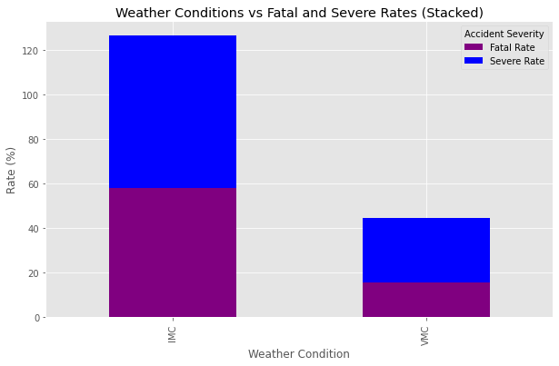
Data analysis: weather conditions & accident severity
Number of and severity of accidents by weather conditions:
Accidents in Instrument Meteorological Conditions (IMC) - which include poor visibility situations such as fog, heavy rain, low clouds, or storms, where pilots must rely primarily on instruments for navigation - accounted for 5,949 accidents, with a 58.13% fatal rate and a 68.65% severe rate. These accidents are far more likely to be fatal or severe, showing that poor weather significantly increases the risk of serious outcomes.
Accidents in Visual Meteorological Conditions (VMC) - referring to clear weather conditions where pilots can navigate safely using visual cues - accounted for 76,417 accidents, with a 15.68% fatal rate and a 28.95% severe rate.. Although more accidents occur under VMC, this reflects higher flight activity in good weather rather than greater risk.
The accidents under VMC are less likely to be fatal or severe, suggesting that better visibility and calmer weather reduce the severity of accidents and improve overall flight safety. The lower fatal and severe rates suggest that better visibility reduces accident severity and improves overall flight safe.
The aviation business should pay special attention to IMC conditions, where the risk of severe accidents is significantly higher.
Weather.Condition | Total_accidents (n) | Fatal_rate (%) | Severe_rate (%)
IMC | 5,949 | 58% | 69%
VMC | 76,417 | 16% | 29%

Slide 7
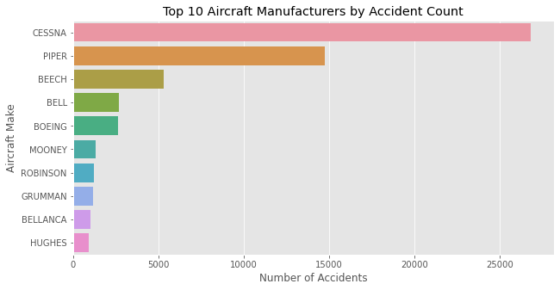
Data analysis: aircraft model & make and accident severity
Number of and severity of accidents by aircraft model and make:
Cessna (26,839 accidents) and Piper (14,744) recorded the highest number of accidents, though their fatal and severe rates remain moderate at 34.8% and 18.1% for Cessna, and 44.5% and 20.6% for Piper.
Beechcraft (5,332 accidents) shows fewer accidents but among the highest fatal rate (69.4%), indicating higher severity when incidents occur.
Boeing (2,652 accidents) has far fewer accidents and very high severity rates (301% fatal, 80% severe), reflecting weak commercial safety systems.
It is critical to invest in aircraft with lower accident severity, focusing on reliable models with manageable risk profiles such as Cessna and Piper, while avoiding high-severity makes like Beechcraft and Boeing. Strengthening safety systems for general aviation aircraft will further support safer and more consistent operations.
Make | Total_accidents (n) | avg_fatal_rate (%) | avg_severe_rate (%)
CESSNA | 26,839 | 35% | 18%
PIPER | 14,744 | 44% | 21%
BEECH | 5,332 | 69% | 20%
BELL | 2,706 | 48% | 32%
BOEING | 2,652 | 306% | 80%
MOONEY | 1,322 | 51% | 19%
ROBINSON | 1,223 | 50% | 18%

Slide 8
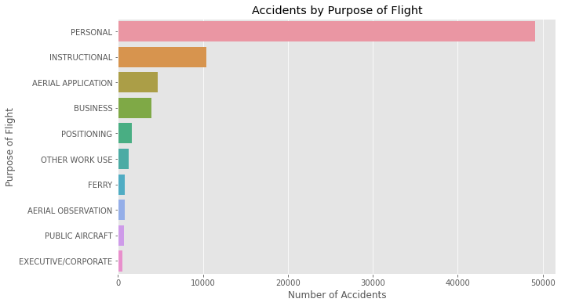
Data analysis: purpose of flight and accident severity
Number of and severity of accidents by purpose of flight:
Personal flights recorded the highest number of accidents (49,076), followed by instructional flights (10,442) and aerial application flights (4,686). While personal flights dominate in numbers, their fatal (20.9%) and severe (34.6%) rates are moderate.
On the other hand, instructional flights show lower severity (9.2% fatal, 18.8% severe), suggesting safer environments due to structured supervision and training.
At the extreme end, specialized operations such as air shows (99 accidents, 39.4% fatal) and firefighting (40 accidents, 47.5% fatal) show the highest severity, reflecting higher operational risk.
It is critical therefore to invest in safer, professionally managed operations - such as training, business, or charter flights -while avoiding high-risk activities like personal or air show operations.
Purpose_of_Flight | Total_accidents (n) | Fatal_rate(%) | Severe_rate (%)
PERSONAL | 49,076 | 21% | 35%
INSTRUCTIONAL | 10,442 | 9% | 19%
AERIAL APPLICATION | 4,686 | 11% | 23%
BUSINESS | 3,971 | 26% | 37%
EXECUTIVE/CORPORATE | 542 | 25% | 35%
AIR SHOW | 99 | 39% | 53%
FIREFIGHTING | 40 | 48% | 60%

Slide 9
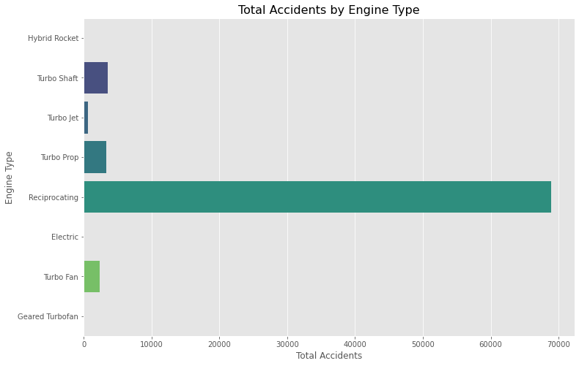
Data analysis: engine type and accident severity
Number of and severity of accidents by engine type:
Reciprocating engines recorded the highest number of accidents (68,885) but with relatively moderate fatal (18.8%) and severe (31.0%) rates, indicating that while these engines are common, accidents involving them tend to be less to moderate catastrophic.
Turbo Shaft (3,583 accidents, 21.9% fatal, 37.8% severe) and Turbo Prop engines (3,324 accidents, 23.8% fatal, 33.6% severe) show slightly higher severity levels, suggesting a greater risk profile despite lower overall frequencies.
In contrast, modern engines such as Turbo Fan (2,387 accidents, 7.9% fatal, 25.4% severe) demonstrate stronger safety outcomes, reflecting improved design and reliability.
It is critical to invest in aircraft powered by more reliable and modern engine types like Turbo Fan, while strengthening safety protocols for Turbo Shaft and Turbo Prop operations, which remain slightly more prone to severe outcomes.
Engine_Type | Total_accidents (n) | Fatal_rate (%) | Severe_rate (%)
Reciprocating | 68,885 | 19% | 31%
Turbo Shaft | 3,583 | 22% | 38%
Turbo Prop | 3,324 | 24% | 34%
Turbo Fan | 2,387 | 8% | 25%
Turbo Jet | 684 | 19% | 35%
Electric | 10 | 20% | 30%
Hybrid Rocket | 1 | 100% | 100%

Slide 10
Recommendations
1. Focus on safer flight operations
Most accidents occur in personal flights (49,000+), while instructional and business flights show much lower fatality rates (under 20%).
Therefore, the business should concentrate its initial operations in structured, professionally managed segments such as training, business, or charter flights, where safety oversight and crew discipline are stronger.
2. Invest in aircraft and engine types with lower accident severity
Aircraft like Cessna and Piper have moderate severity despite high usage, whereas Beechcraft and Boeing show higher fatality rates. Similarly, Turbo Fan engines have safer performance (8% fatal)
Therefore, the business should prioritize reliable, lower-severity aircraft and modern engines such as Turbo Fan or Reciprocating for safer, more sustainable operations.
3. Strengthen weather preparedness and safety systems
Poor weather (IMC) accidents are nearly four times more fatal than those in clear conditions (VMC).
Therefore, the business should invest in advanced weather monitoring, pilot IMC training, and strong safety management systems to mitigate visibility and climate-related risks.

Slide 11

Thank you!

